Slide 1


ABC Electronics

Slide 2

Analyzing and Visualizing Regional Sales Performance

Slide 3
Task 1: Filter the dataset to find all orders placed in the "South" region for the "Electronics" category within the last year.
Copied the data set in different sheet in the same workbook.
Select ALL > Insert > Table.
Filtered the region into “SOUTH” and Product Category as “ELECTRONICS”.
Filter steps;
Home > Sort & Filter > Filter

Slide 4
Task 2: Use text functions (TRIM, UPPER, LOWER) to clean and standardize the Region and Product Category columns.
Copied the data set in different sheet in the same workbook. Select ALL > Insert > Table.
TRIM : =TRIM() / Remove the unwanted space.
UPPER: =UPPER() / To make all text as uppercase.
LOWER: =LOWER() / To make all text as lowercase.
Used all these text functions in the Region and Product category columns.

Slide 5
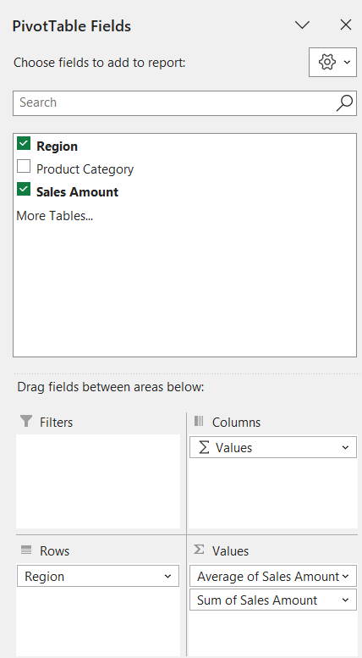
Task 3: Calculate the average sales amount for each region and merge this calculated value back into the dataset based on the Region column.
Copied the data set in different sheet in the same workbook. Select ALL > Insert > Table.
Average: =AVERAGE(Cell Range)
Choose the location and insert the PIVOT table and choose the field as Region and sales amount.
Drag region in the ROWS, Sales amount in the Values.

Slide 6
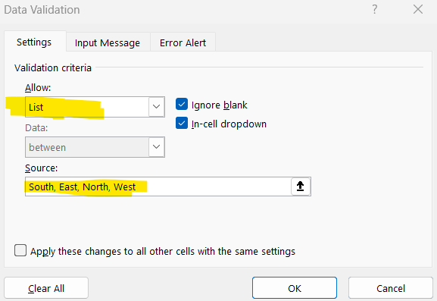
Task 4:
Calculate total sales for each region using the SUM formula.
Copied the data set in different sheet in the same workbook. Select ALL > Insert > Table.
SUM: =sum(Cell range)
Choose the location and insert the PIVOT table and choose the field as Region.
Data > Data Validation.
Allow: List /Source: Regions.
And click OK.
Drop down will occur with All Regions.

Slide 7
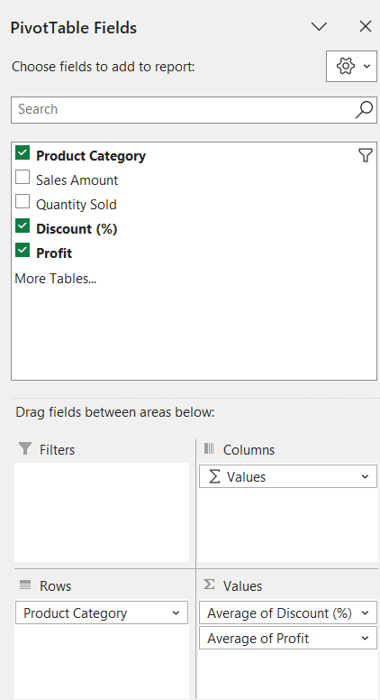
Compute the average discount percentage and profit for the "Furniture" category using AVERAGE.
=SUMIF(Range, Criteria, Sum range)
Choose the location and insert the PIVOT table and choose the field as Region and sales amount.
Drag “Product Category” to Rows, “Discount & Profit” to Values.
Finally filter the category as Furnitures.

Slide 8
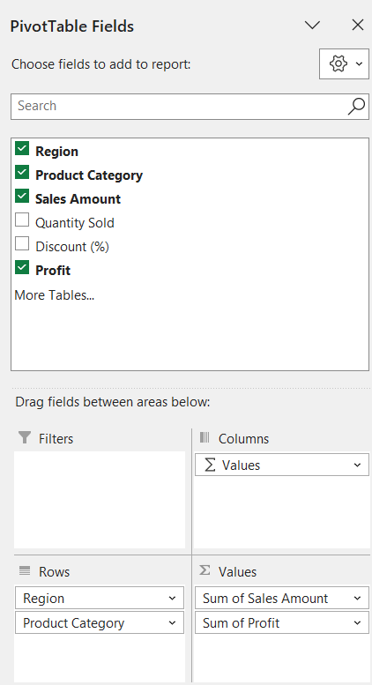
Task 5: Create a Pivot Table to summarize total sales and profit by region and product category. Add slicers to filter by region or category dynamically.
Choose the location and insert the PIVOT table and choose the field from Region to Profit.
Drag “Region & Product Category” to Rows.
And “Sales Amount & Profit” to Values.
Insert > Slicer, and select the range.
Choose the range to view as slicer.

Slide 9
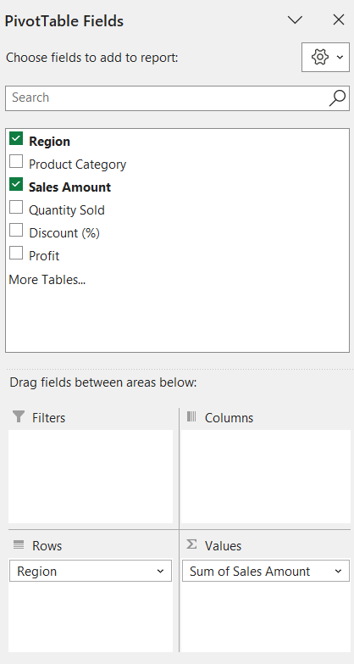
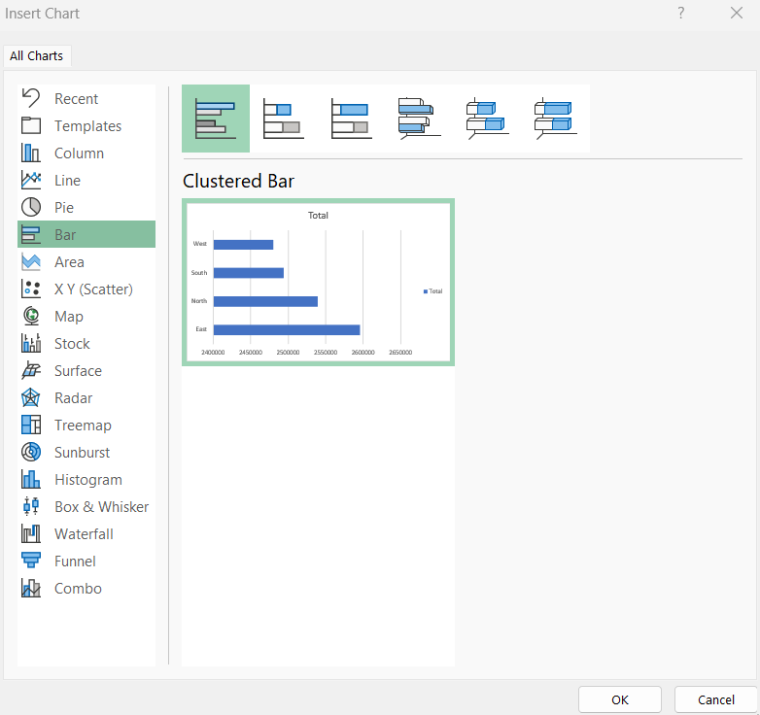
Task 6: (A)Create a bar chart showing total sales for each region.
Choose the location and insert the PIVOT table and choose the field from Region to Profit.
Drag “Region to Rows” and Sales amount to Values.
Insert > Pivotchart > Bar.

Slide 10
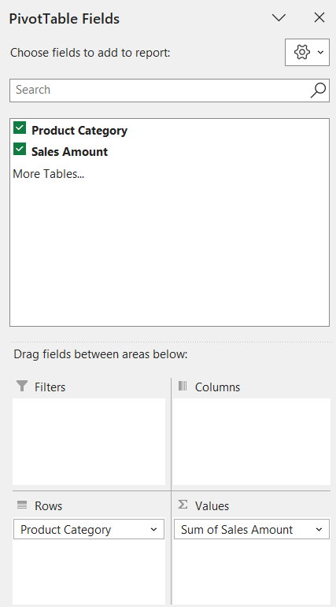
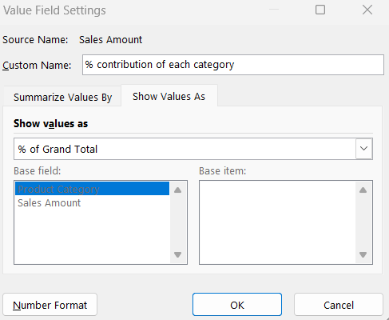
Task 6: (B)Create a pie chart showing the percentage contribution of each product category to total sales..
Choose the location and insert the PIVOT table and choose the field from Region to Profit.
Drag “Product Category to Rows” and Sales amount to Values.
Insert > Pivotchart > Bar.

Slide 11
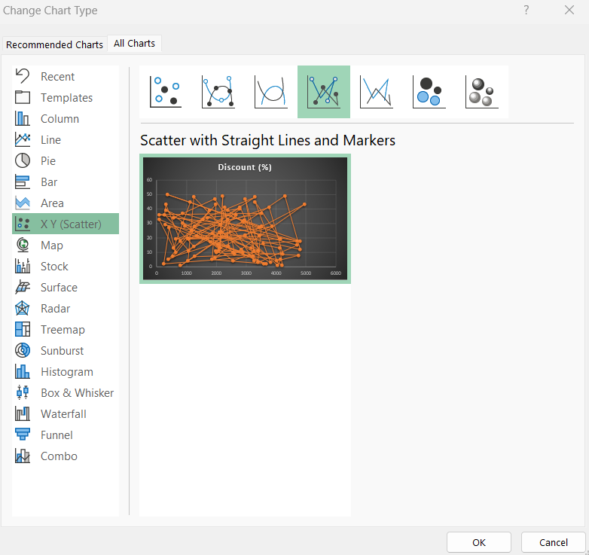
Task 7: Perform a simple regression analysis to understand the impact of Discount (%) on Sales Amount. Use a scatter plot to visualize the relationship.
Select the columns of Sales amount and Discounts.
Insert > Recommended Charts > X Y Scatter.
Choose the type of the scatter chart.
Click OK.

Slide 12
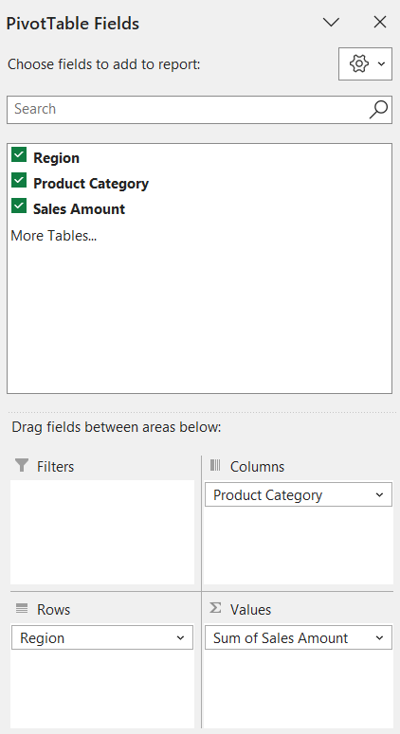
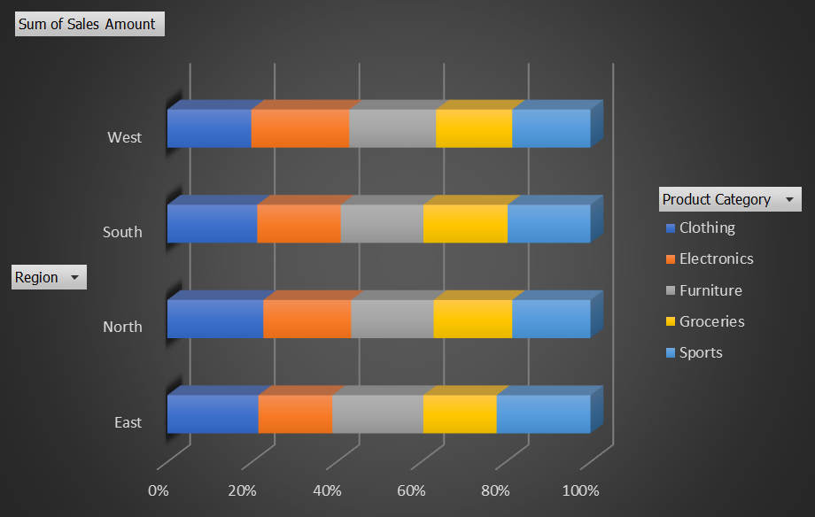
Task 8: Create a stacked bar chart showing total sales by region and product category.
Choose the location and insert the PIVOT table and choose the field from Region to Profit.
Drag “Product Category to Column”, “Region to Rows” and “Sales Amount to Values”.
Insert > PivotChart > Bar > Stacked Bar.

Slide 13
Task 9: A)Create a dashboard showing key metrics (e.g., total sales, total profit, highest-selling product category).
Task 9: A)Add interactive elements like slicers or dropdowns for dynamic filtering.
Insert > Insert WordArt. Choose the design type and made the header.
Insert > 3D Model. Chose the business based image on the left.
Copied the data set in different sheet in the same workbook. Select ALL > Insert > Table.
Choose the location and insert the PIVOT table.
Sum of sales in different region and category.
Sum of profit in different region and category.
Sum of quantity sold in different category.
Sum of quantity sold in different Region.
Sum of sales in different time periods.
Choose the graph and Click Insert > Slicer, apply the required range to get a results.

Slide 14
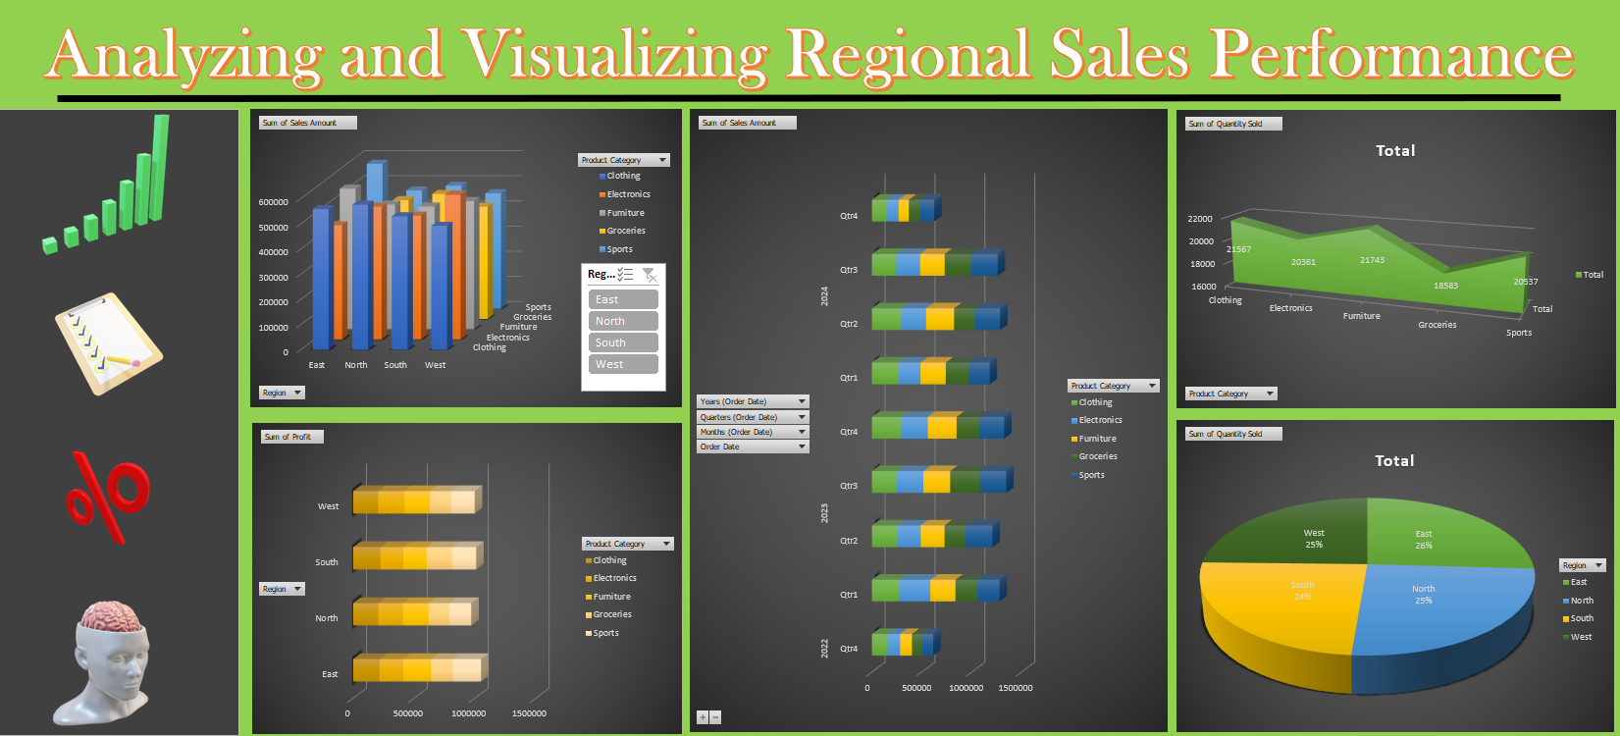

Slide 15
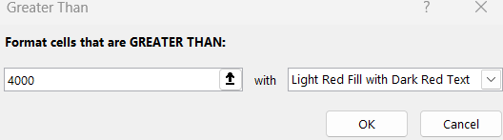
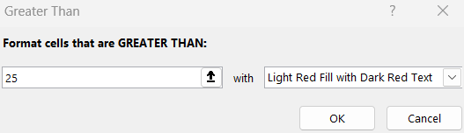
Task 10: Use conditional formatting to highlight orders with a profit margin greater than 50% or sales amounts above ₹4000.
Select the “Sales Amount” column. Click Home > Conditional Formatting > Highlight cell rule > Greater than”.
Enter 4000 since the condition is above 4000. And click OK.
Select the “Sales Amount” column. Click Home > Conditional Formatting > Highlight cell rule > Greater than”.
Enter 25 since the condition is above 50%. And click OK.

Slide 16
THANK YOU

